Slide 1
Draft Site Allocations Development Plan Document
West Norwood meeting – 24 January 2022 (via Teams)

Slide 2
Overview
Part of statutory development plan, follows Local Plan adoption (Sept 2021)
Helps deliver Borough Plan objectives – sustainable and inclusive growth
‘Regulation 18’ consultation 10 January to 22 February 2022 (Cabinet 13 Dec 2021)
Consulting on full draft SADPD, with evidence and draft Sustainability Appraisal
Inviting comments on the subject of the Draft SADPD and proposed approach to the sites included in it

Slide 3
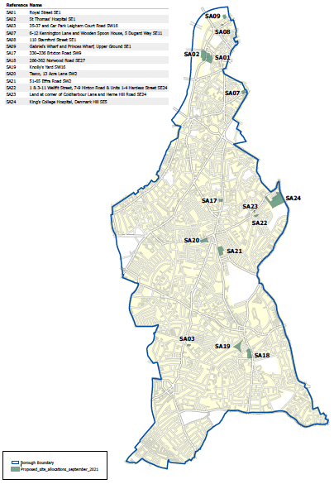
Fourteen sites (three already allocated)
Waterloo Site 1 Royal Street
Site 2 St Thomas’ Hospital
Site 8 Stamford Street
Site 9 Gabriel’s Wharf & Princes Wharf
Kennington Site 7 6-12 Kennington Lane & WS House
Brixton Site 17 330-336 Brixton Road
Site 20 Tesco, Acre Lane
Site 21 51-65 Effra Road
L’borough Junction Site 22 Wellfit Street/Hardess Street
Site 23 Coldharbour Lane/Herne Hill Road
Site 24 King’s College Hospital
Streatham Site 3 Leigham Court Road car park
West Norwood Site 18 286-362 Norwood Road
Site 19 Knolly’s Yard

Slide 4
Rationale for allocations
Not necessary for every site
Site-specific parameters for type and scale of development expected and associated public benefits and place-making objectives
Address site-specific circumstances - more tailored than borough-wide policies
Articulate vision and potential of land assembly/comprehensive approach
Encourage landowners to consider potential of their site
Identify additional sites appropriate for tall buildings
Enable key strategic infrastructure (e.g. hospital reconfiguration)

Slide 5
Approach
Design-led optimisation of development capacity – London Plan policy D3
“A design-led approach to optimising site capacity should be based on an evaluation of the site’s attributes, its surrounding context and its capacity for growth to determine the appropriate form of development for that site.”
Analysis of optimum mass and height having regard to planning constraints e.g. neighbouring uses, views, townscape and heritage assets
Contribution to place-making e.g. inclusive public realm, connectivity, active travel and healthy routes, safety, local distinctiveness, design quality, urban greening, town centres
Affordable housing thresholds
New and renewed community and commercial floorspace, jobs, skills
Expectation of exemplary response to net zero carbon and climate change adaptation
All other development plan policies and guidance will also apply (Local Plan, London Plan, Supplementary Planning Documents, Mayoral guidance)

Slide 6
What to comment on
Draft vision for each site
Draft policy wording for each site
Contextual information about each site
Supporting evidence for approach taken on each site
Draft sustainability appraisal for each site
  Appraised against 18 sustainability objectives covering equality, health and well-being/ reduction in health inequality, inclusive environments, safety, economy, environment, green infrastructure, air quality etc
Anything else you would like to say

Slide 7
How to respond
Respond via Commonplace or by email to sadpd@lambeth.gov.uk
Link: https://lambethsadpd.commonplace.is/
Send comments by 11pm 22 February 2022
All written comments will be given full consideration prior to next version of the Draft SADPD. That version will be accompanied by a consultation report, setting out a response to the written comments made at this stage.

Slide 8
Draft SADPD process and timetable
We are here
Consultation on Draft SADPD
‘Reg 18’
Jan-Feb 2022
Pre-submission publication of Proposed Submission Version SADPD
Submission for Independent Examination
2022/23
Examination
Hearing
’Main Modifications’
Inspector’s report
Adoption
2023/24
Sustainability appraisal

Slide 9
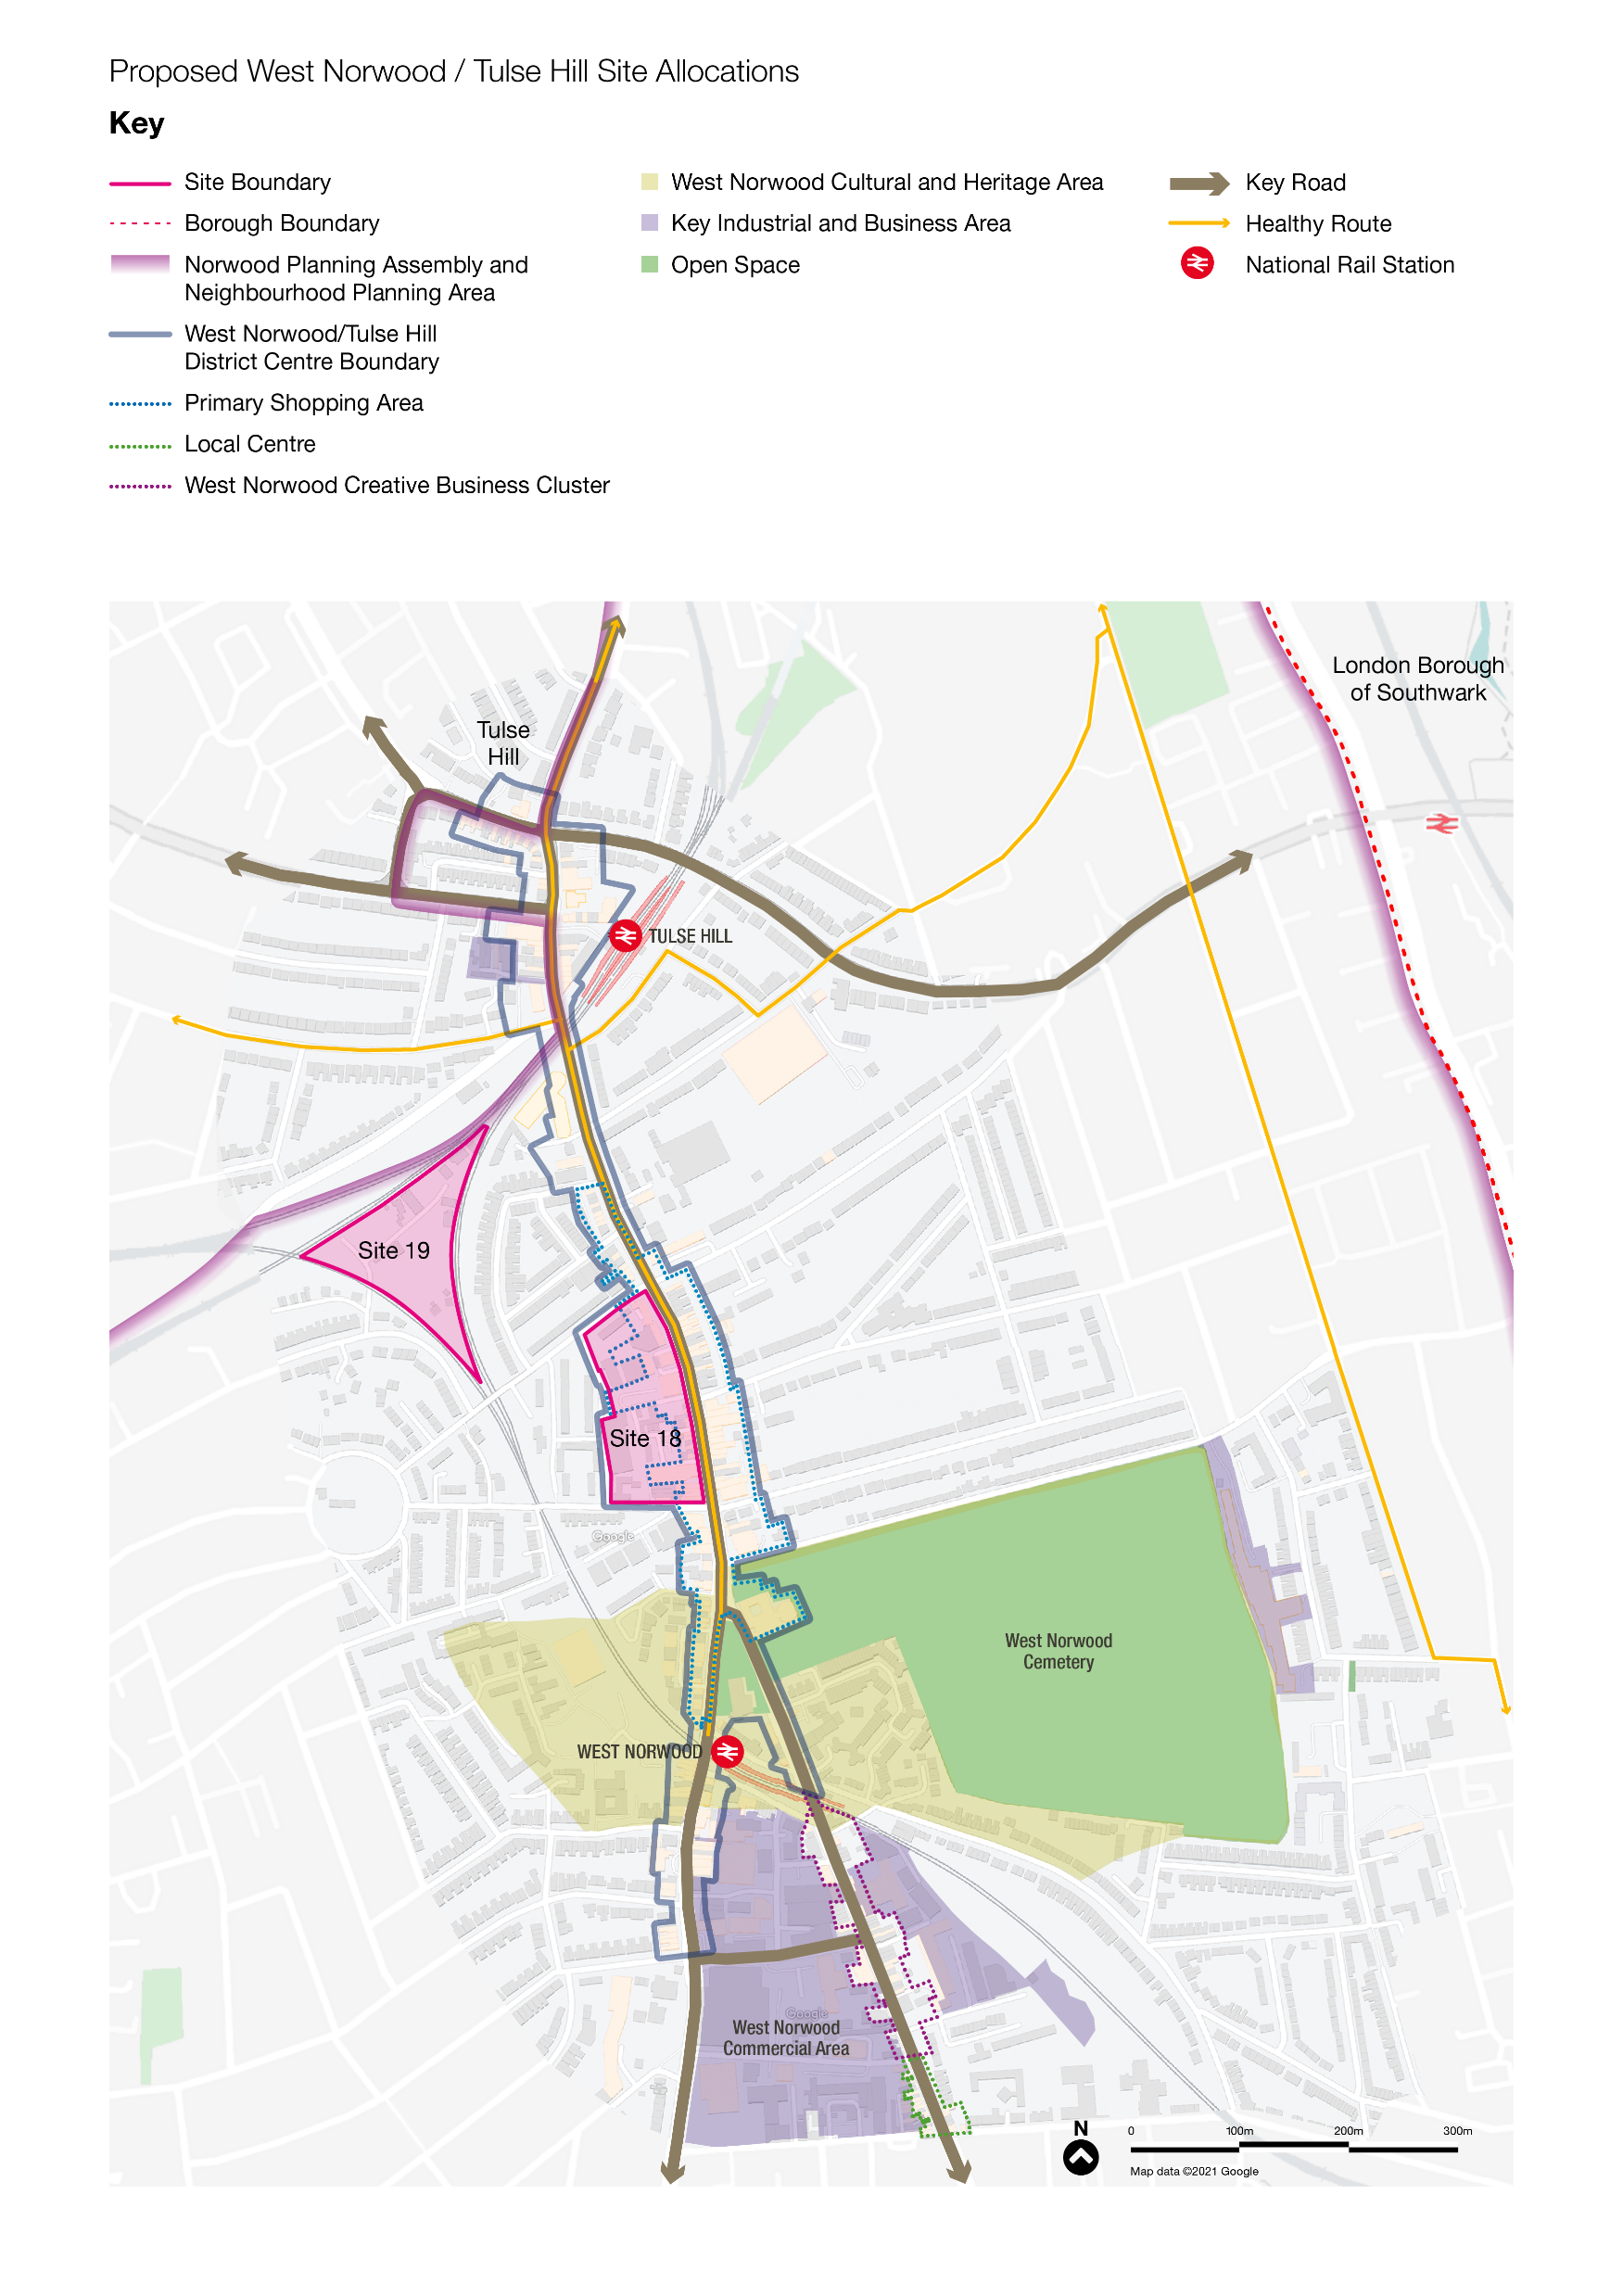
West Norwood / Tulse Hill sites

Slide 10
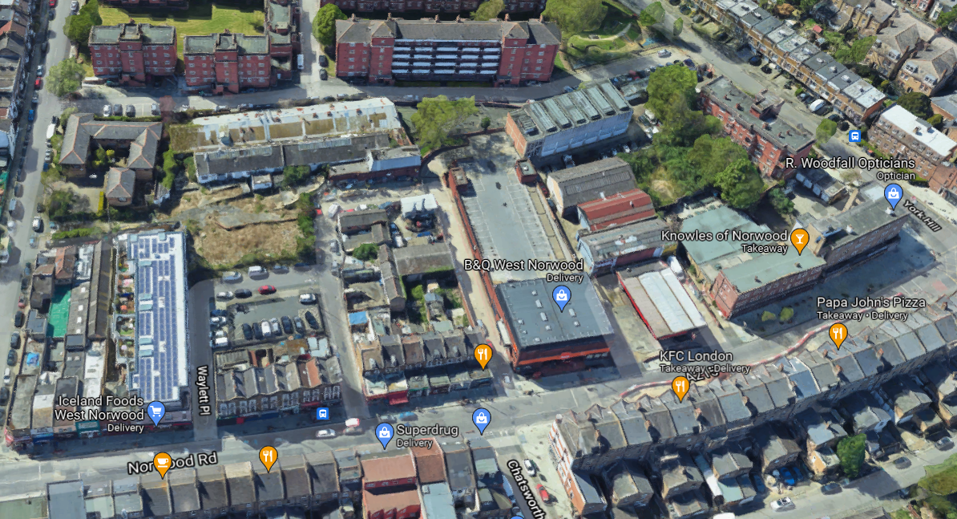
Site 18:
286-362 Norwood Road

Slide 11
286-362 Norwood Road
Site already allocated – requires updating
Enable full optimisation and LBL-led regeneration – phased
Appropriate for tall building in centre of site
Approx. 390 to 470 residential units (gross)
35-50% affordable housing threshold
Approx. 5,000 to 7,000 sqm commercial/community floorspace (gross), incl. workspace to support growing creative cluster
Renewed town centre frontage, new public realm, urban greening

Slide 12
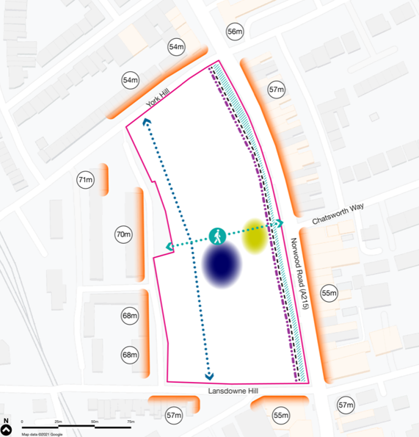
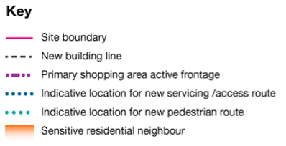
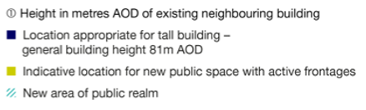

Slide 13
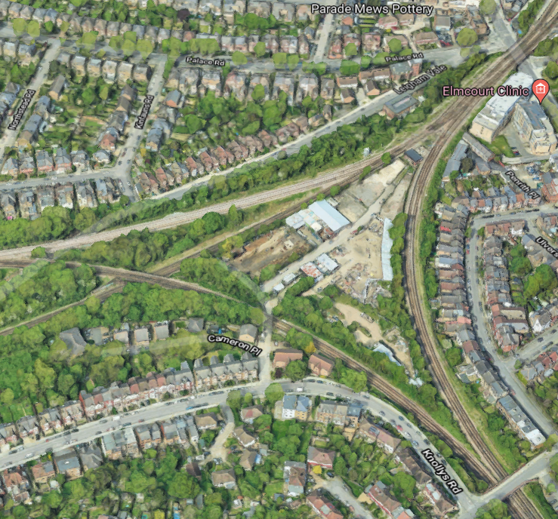
Site 19:
Knolly’s Yard

Slide 14
Knolly’s Yard
KIBA with potential for intensification/co-location with residential
No less than 1,500 sqm flexible light industrial workspace (creative/clean tech)
Approx 400-430 residential units
50% affordable housing threshold
New public realm, new urban greening/biodiversity
Pedestrian/cycle access from hinterland to Tulse Hill town centre
Appropriate in part for tall buildings

Slide 15
